Slide 1


Nalgonda Election Analysis Report
rekhatagore13@gmail.com
Tagore Rekha

Slide 2
Contents
About the dataset | Part 1
Relevant inquiries | Part 2

Slide 3

About the dataset

Slide 4
About the dataset
This report analyzes Nalgonda election data from three CSV files. Key findings include INC receiving 107,405 votes and BJP receiving 7,828 votes. Komatireddy Venkat Reddy (INC) secured 52.64% of votes, while Kancharla Bhupal Reddy (BRS) got 26.01%. The average votes per candidate are 28,388.43, with a standard deviation of 36,859.90.

Slide 5

Relevant inquiries

Slide 6
Party vote share percentages
Dominant Party: INC secured the highest vote share at 52.64%, indicating a strong mandate.
Second Largest Party: BRS followed with 26.01%, showing a significant gap from INC.
Minor Parties and NOTA: AIFB, BJP, and others, including NOTA, each received less than 14%, highlighting concentrated votes among the top two parties.

Slide 7
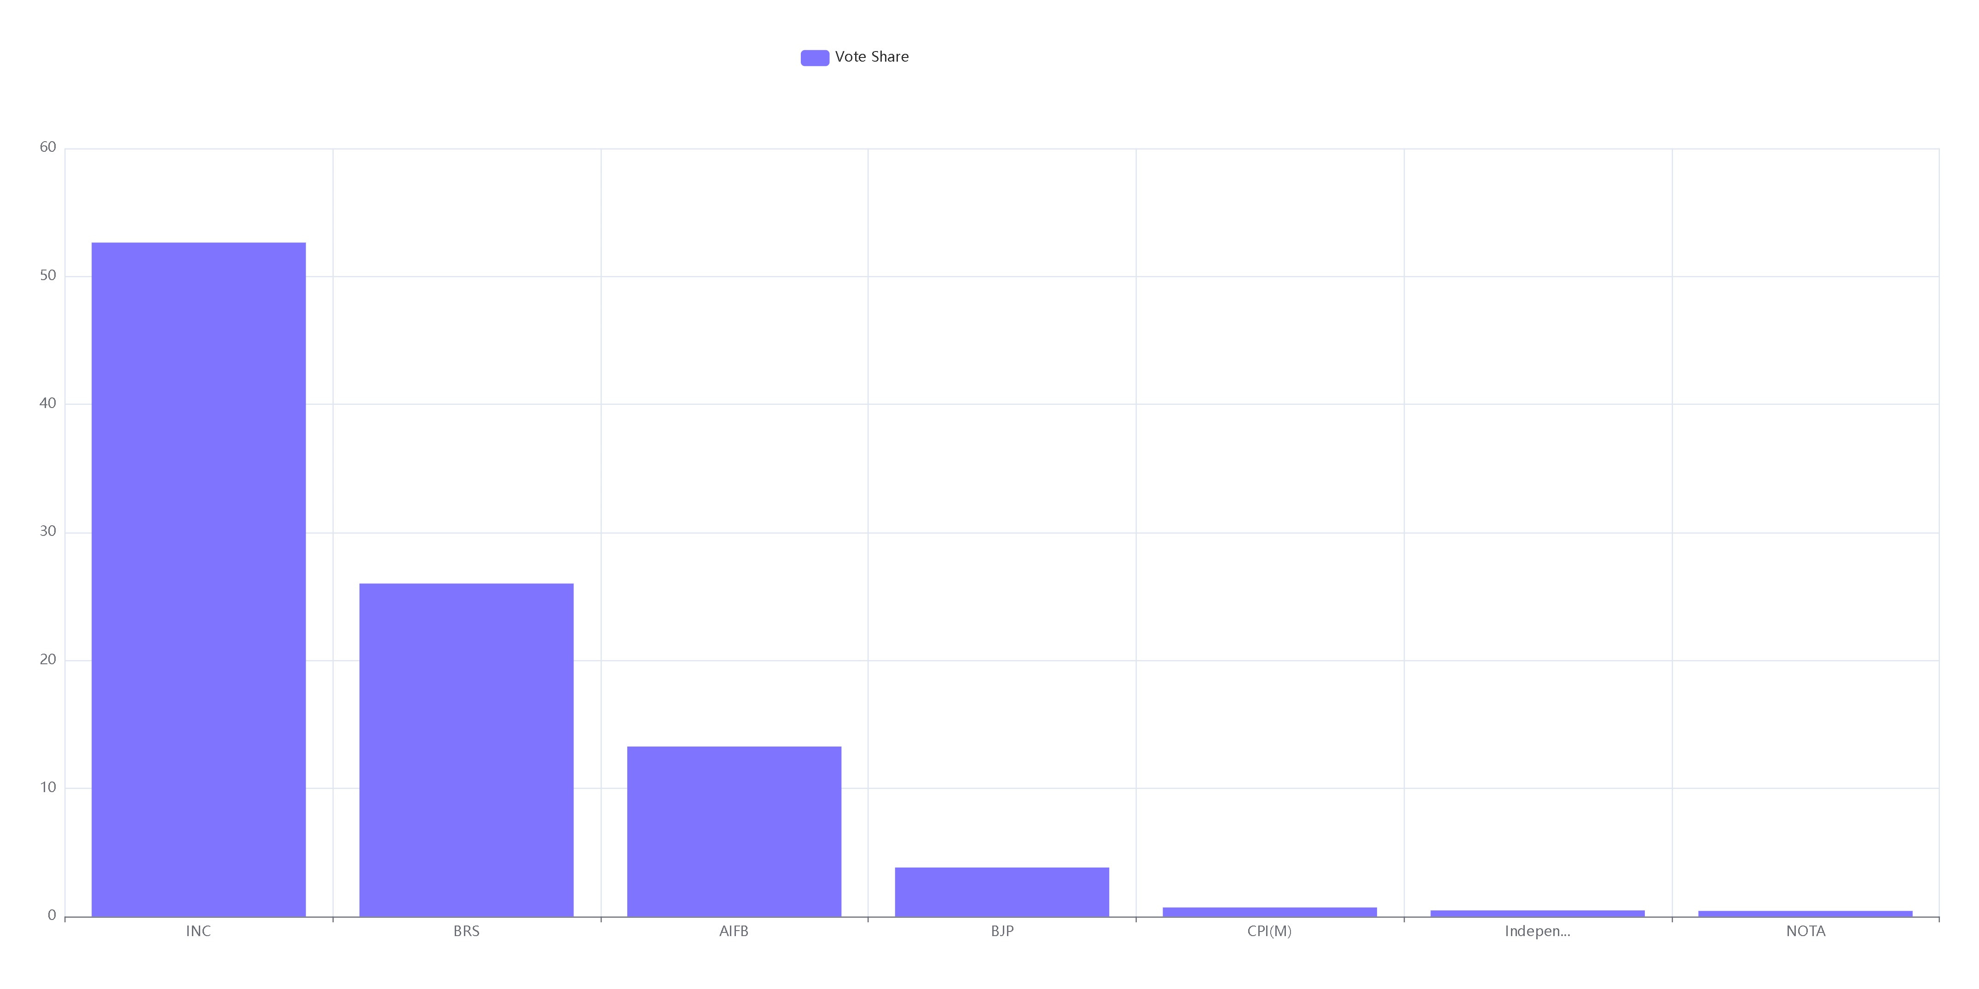

Slide 8
Top 3 Candidates by Votes
Komatireddy Venkat Reddy leads with 107,405 votes, more than double the second place.
Significant Vote Gap: A clear hierarchy in voter preference, with a notable drop-off after the top two candidates.
Visual Insight: Bar chart effectively illustrates the vote distribution and candidate ranking.

Slide 9
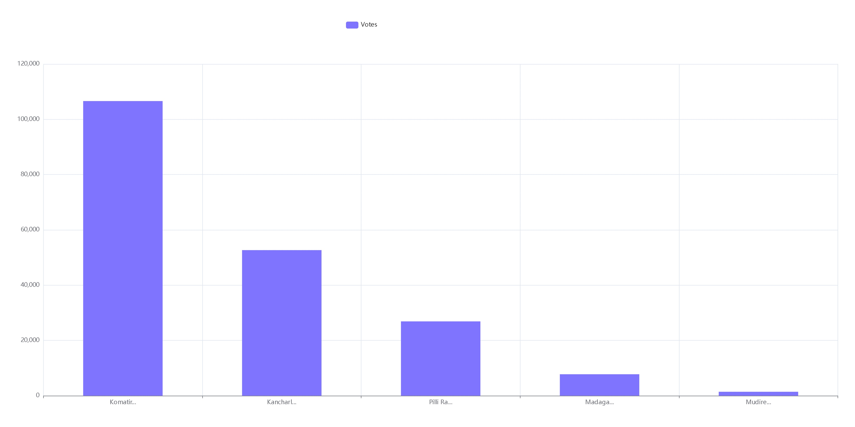

Slide 10
rekhatagore13@gmail.com
Tagore Rekha

